Slide 1
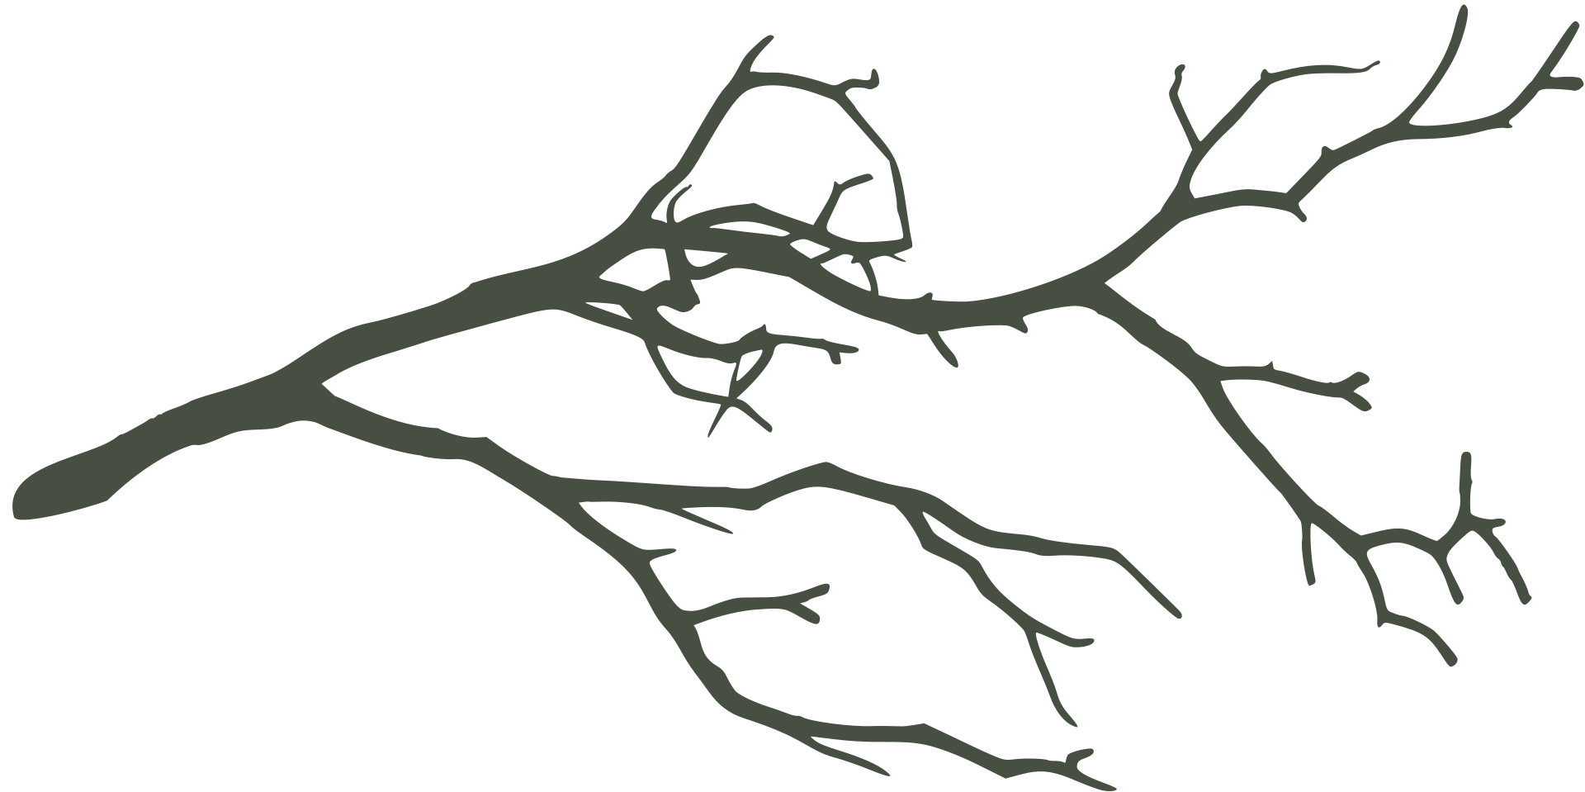
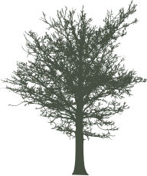

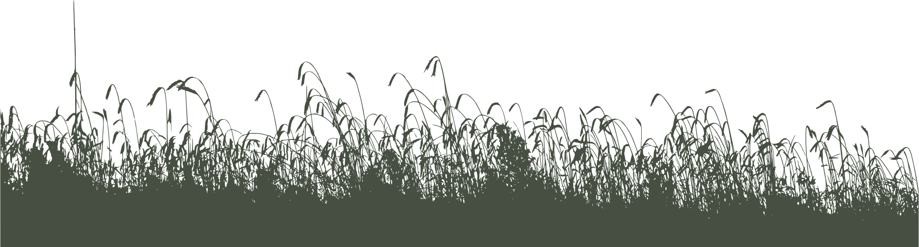
Environmental Drivers of Arthropod Diversity across Spartina alterniflora invaded saltmarshes
Gabi Diez, Jared de Silva,
Golshan Sharbatdar Alaei, Samara Tanz
Notes:
So we chose to look at a paper that discusses the env drivers of arthro diversity across Spartina alterniflora invaded saltmarshes in the Yangtze estuary of China

Slide 2

PROJECT OVERVIEW
Introduction
Hypothesis
Methods & Results
Discussion
Questions?
Notes:
variables associated w PC1/PC2 are the best drivers for diversity
community is a random effect!
- every community has a baseline diversity when PC1 is low
- include what plant/soil combos on each side of PC mean plot thing ~ can delete this, just wrote what I partially overheard

Slide 3
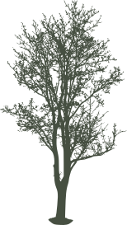
BACKGROUND
Between 2012-2017, Spartina alterniflora has been removed and Phragmites australis (native grass) has been transplanted
Investigated how arthropod assemblages and their interaction between trophic levels change with the restoration of native grasses
Analyzed plant and soil traits that might explain the change
Jiang, J., Zhao, Y., Guo, Y., Gao, L., Richards, C.L., Siemann, E., Wu, J., Li, L., Ju, R. (2022). Restoration of native saltmarshes can
reverse arthropod assemblages and trophic interactions changed by a plant invasion. Ecological Applications - Ecological
Society of America, 34, 1. https://doi-org.myaccess.library.utoronto.ca/10.1002/eap.2740
Notes:
the paper chose to investigate how arthropod assemblages and their interactions between trophic levels change as their community is restored from invaded Spartina to the native Phragmites.
The saltmarshes of the Yangtze estuary of China were invaded by Spartina and later restored from 2012-2017.
nutrient cycling and other biological cycles essential for healthy ecosystem functioning
Saltmarshes in the Yangtze estuary of China have been invaded by Spartina alterniflora where by the end of 2015 , 545 km2 has been taken over

Slide 4
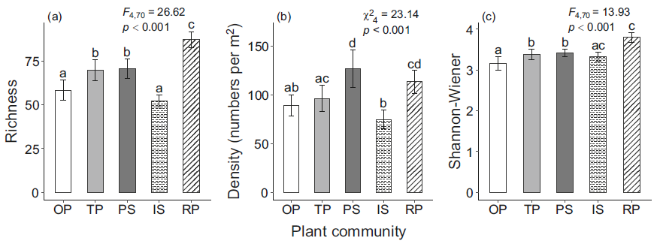
ORIGINAL RESULTS
“Spartina invasion was associated with the changes of arthropod diversity and their trophic-level interactions in the Yangtze estuary”
2. “Spartina-induced changes in arthropods would be removed after the restoration of the saltmarshes with the native Phragmites”
Notes:
The changes of diversity and interactions between trophic levels was deemed unknown by the authors as they came up with their hypotheses to focus on the changes between communities ranked by a gradient of invaded to restored grasses.
They ultimately found that the traits most responsible for driving changes in arthropod diversity was aboveground biomass, leaf N, plant density, and soil salinity.
**They chose to hypothesize trophic level interaction explained by diversity while we chose to discuss diversity explained by traits**

Slide 5
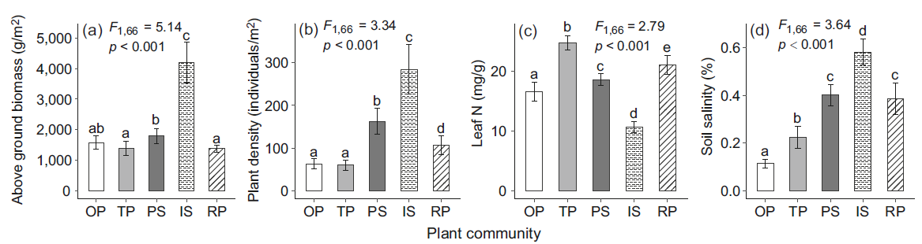
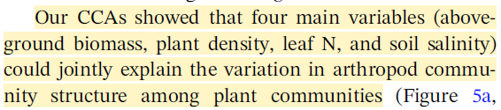
ORIGINAL ANALYSIS
Notes:
We decided to attempt to determine the same results in our own way as a form of verification. Ultimately, we were most interested to what traits drive diversity between all gradients of communities.
We hypothesize:

Slide 6
OUR MAIN QUESTIONS
OUR MAIN QUESTIONS:
Do different saltmarsh communities significantly differ in their Shannon diversity?
Within an average(?) community, which soil or plant trait(s) is/are the strongest predictor of Shannon diversity?
Do these align with the original authors’ findings?
Does/do the predictor trait(s) differ based on different community types?
Notes:
include data sources used, statistical tests and why used,

Slide 7
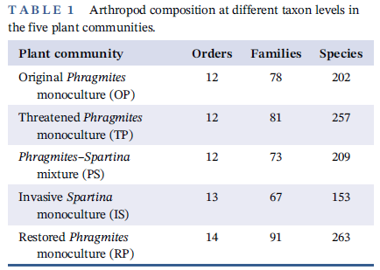
ORIGINAL DATA
OP: Original Phragmites monoculture
TP: Threatened Phragmites monoculture
PS: Phragmites–Spartina mixture
IS: Invasive Spartina monoculture
RP: Restored Phragmites monoculture
Raw data: Arthropod list, Plant traits, and Soil traits. To test our hypothesis, we decided to focus on which plant/soil traits would be most significant in explain variation across arthropod communities.
Notes:
The authors established 15 plots across 5 communities as a gradient. The raw data included 4 sheets of data: Arthropod list, plant traits, soil, traits, and stable isotopes (which was not used in our calculations of diversity)

Slide 8
OUR HYPOTHESES
H0.2 Soil and Plant traits represented by principal component axes do not differ in how they predict arthropod diversity across different communities.
H2: Soil and Plant traits represented by principal component axes differ in how they predict arthropod diversity across different communities.
H0: Soil and plant traits represented by principal component axes (PC1 and PC2) do not significantly predict arthropod diversity across all communities.
H1: Soil and plant traits represented by principal component axes (PC1 and PC2) are strong predictors of arthropod diversity across all communities.
Notes:
We decided to attempt to determine the same results in our own way as a form of verification. Ultimately, we were most interested to what traits drive diversity between all gradients of communities.
We hypothesize:

Slide 9
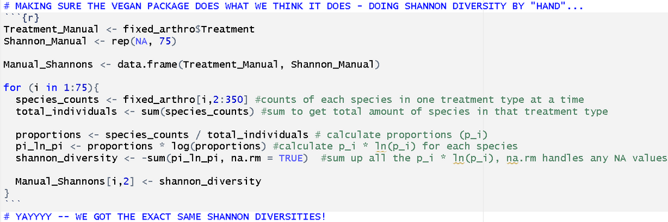
METHODS
OKAY! FIRST WE NEEDED TO CALCULATE SHANNON DIVERSITIES...
Based on the raw counts of each arthropod species in each saltmarsh, calculate the Shannon diversity “by hand” and compare to original paper’s results
Notes:
include data sources used, statistical tests and why used,

Slide 10
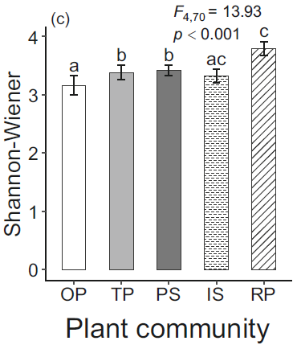

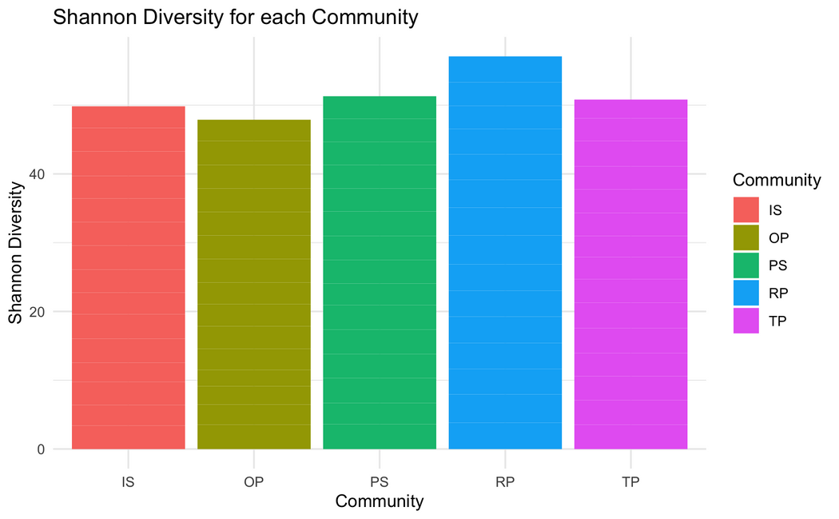
OKAY! FIRST WE NEED TO CALCULATE SHANNON DIVERSITIES...
Based on the raw counts of each arthropod species in each saltmarsh, calculate the Shannon diversity “by hand” and compare to original paper’s results
Significant difference between communities!
Highest: Restored phragmites
Lowest: Original phragmites
Highest: Restored phragmites
Lowest: Original phragmites

Slide 11
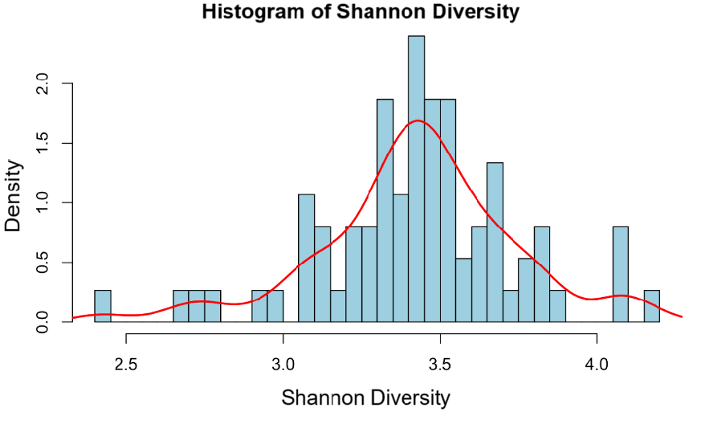
METHODS
NOW, IF WE WANNA FIGURE OUT WHICH PLANT AND SOIL TRAITS ARE THE STRONGEST PREDICTORS, WE CAN PERFORM A
LINEAR REGRESSION TESTING DIFFERENT
PLANT AND SOIL TRAITS!...
BUT!!! WE FIRST NEED TO FIGURE OUT IF WE HAVE TO DO A NORMAL OR GENERALIZED MODEL?!
--> FIND “DISTRIBUTION TYPE” OF THE SHANNON DIVERSITIES!
Notes:
include data sources used, statistical tests and why used,

Slide 12
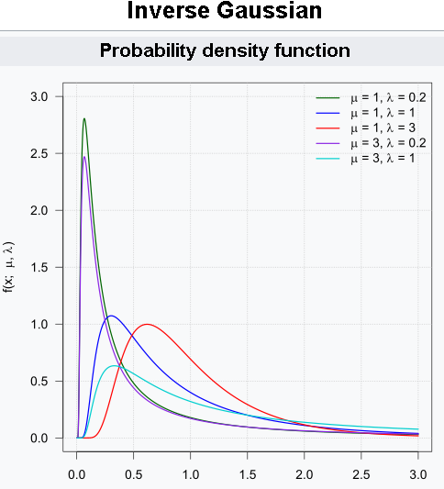
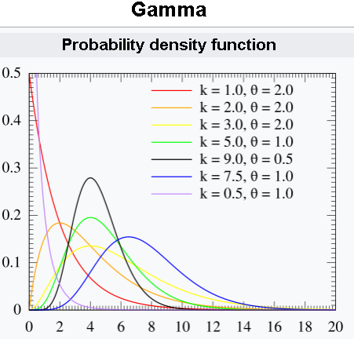
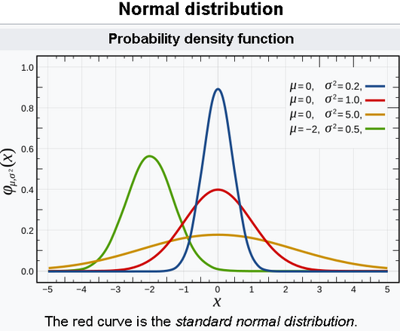
METHODS
Notes:
include data sources used, statistical tests and why used,

Slide 13



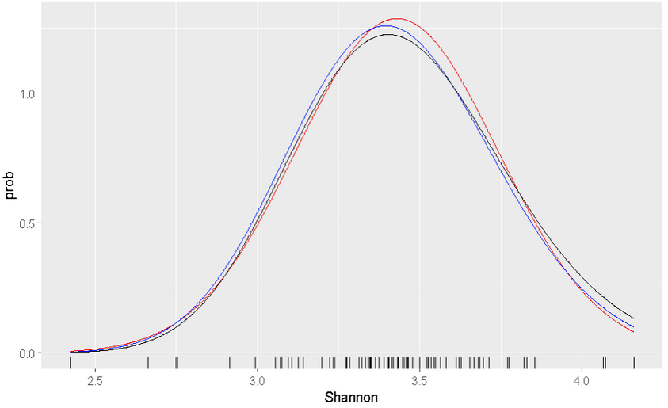
METHODS
PERFORMED LOG-LIKELIHOODS FOR A
NORMAL, GAMMA, AND INVERSE GAUSSIAN DISTRIBUTION
red = normal
blue = gamma
black = inverse guassian
A normal probability density distribution has the HIGHEST LOG-LIKEHOOD!
so we’ll use lmer()
Notes:
include data sources used, statistical tests and why used,

Slide 14
LINEAR REGRESSION TIME!!!
... JOKES!!
Notes:
include data sources used, statistical tests and why used,

Slide 15
WE HAVE NO IDEA WHICH SOIL AND PLANT TRAITS TO CHOOSE... ALSO... WHICH COMBOS???
Notes:
include data sources used, statistical tests and why used,

Slide 16
LET’S DO A PCA!
(Gives us a rough idea of the relationships between different plant and soil traits and which traits vary the most across saltmarshes)
Notes:
We decided to use a principal component analysis to reduce linear dimensionality of our large dataset. It creates a few linear combinations of the original 11 variables that maximally explain the variance of all the variables.

Slide 17
PCA RAW DATA
Proportion of Total Variance
55.64% 10.50% 7.87%
Variable | PC1 | PC2 | PC3
soil_C | -0.3270867 | 0.44789885 | 0.16653515
soil_N | -0.3547747 | 0.37618972 | 0.08033651
soil_P | -0.2202713 | 0.02402190 | -0.10226068
soil_pH | 0.3376054 | -0.22697065 | -0.18848895
soil_sal | -0.2806422 | -0.39256180 | -0.00168089
soil_wat | -0.3539508 | 0.23179513 | 0.02363715
biomass_above | -0.3274486 | -0.30076393 | -0.16619185
plant_dens | -0.3154603 | -0.40412756 | 0.01990098
leaf_N | 0.3142092 | 0.06465172 | 0.20468806
leaf_C | 0.2491950 | 0.08525667 | 0.59299480
leaf_P | 0.1817902 | 0.36430053 | -0.70548522
Notes:
In our case, the PC1 explains more than half of the variance in the data and PC2 10.5%. We believed that utilizing PC1 and PC2 for our models would be representative of the total variance.

Slide 18
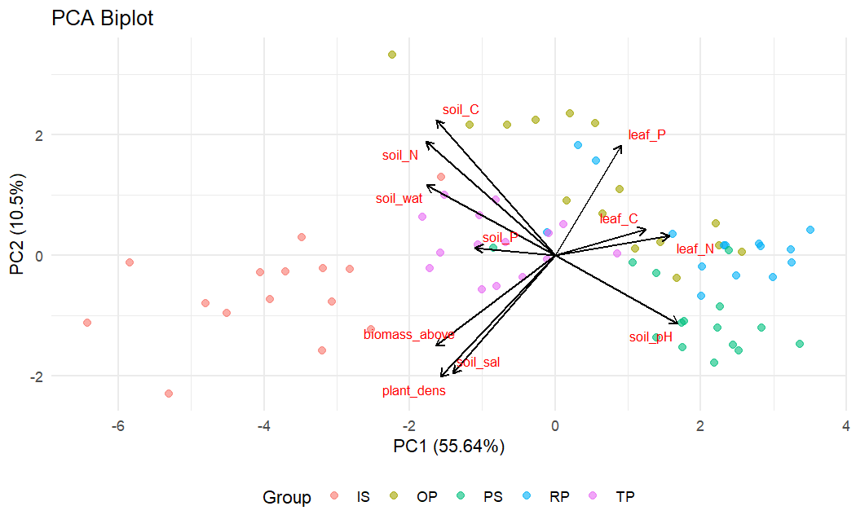
TRAITS VISUALIZED
Notes:
This is what our PCA Biplot looked like with all our traits interacting differently between PC1 and 2.

Slide 19
LET’S CREATE MODELS USING OUR PCA AXES AS PREDICTORS -- SHOULD WE CHOOSE PC1 AND/OR PC2?
Notes:
We want to use our PCA AXES as predictors - how do we create our models?

Slide 20
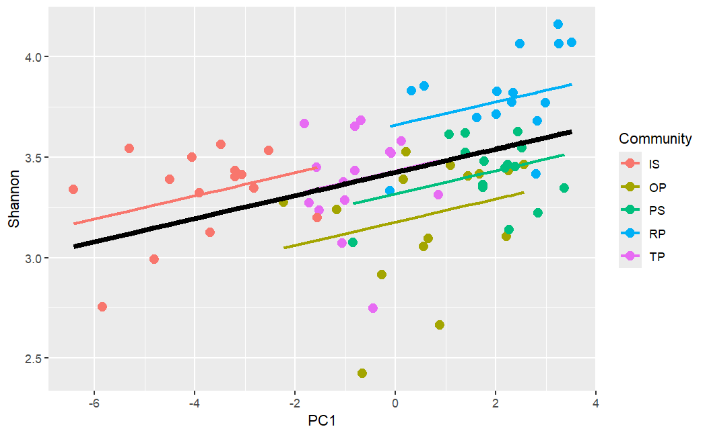
Community Regressions
Notes:
We utilized a grouped vs mean regression graph of Shannon vs PC1 and 2 to assess if the community is a random or fixed effect.
The thick black line corresponds to the fitted values associated with the fixed-effect component of the model. The coloured lines correspond to the fitted values estimated for each Community.
Models with comminity-specific random intercepts AND slopes would be better.

Slide 21
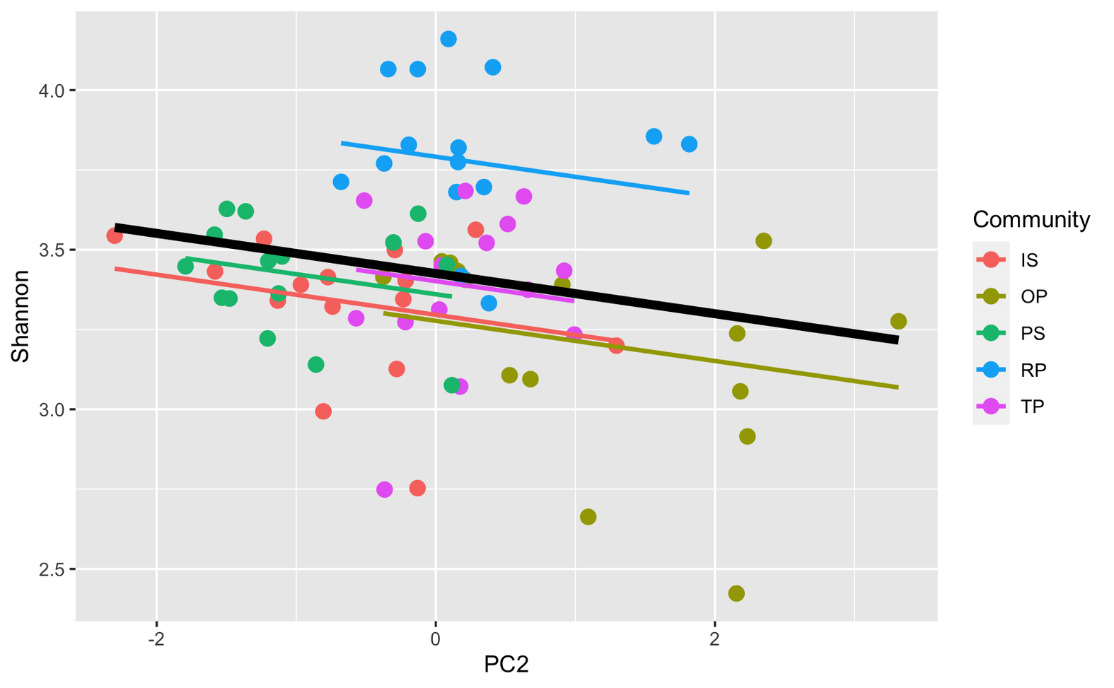

Slide 22
POTENTIAL MODELS
MODEL 1
MODEL 2
Fixed effects: PC1, PC2 + their interaction
Random effect: Community
Fixed effects: PC1 and PC2
Random effect: Community
MODEL 3
MODEL 4
Fixed effects: PC1
Random effect: Community
Fixed effects: PC2
Random effect: Community
Notes:
We created four models with Community as a random effect, utilizing all combinations of PC1 and PC2 as the fixed effects.

Slide 23
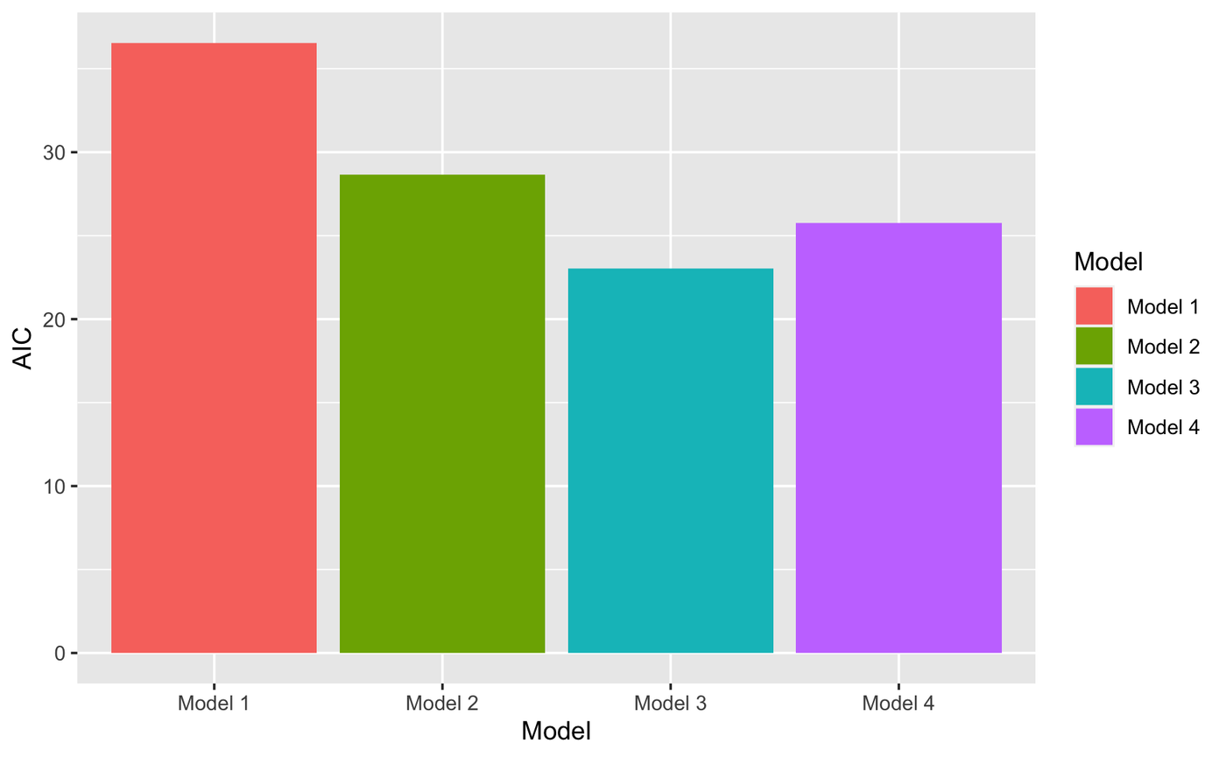
Model 3 is the best !
Fixed effects: PC1
Random effect: Community

Slide 24
METHODS
LOWEST AIC!
Notes:
include data sources used, statistical tests and why used,

Slide 25
BUT WHAT DOES PC1 REALLY MEAN?...
Notes:
include data sources used, statistical tests and why used,

Slide 26
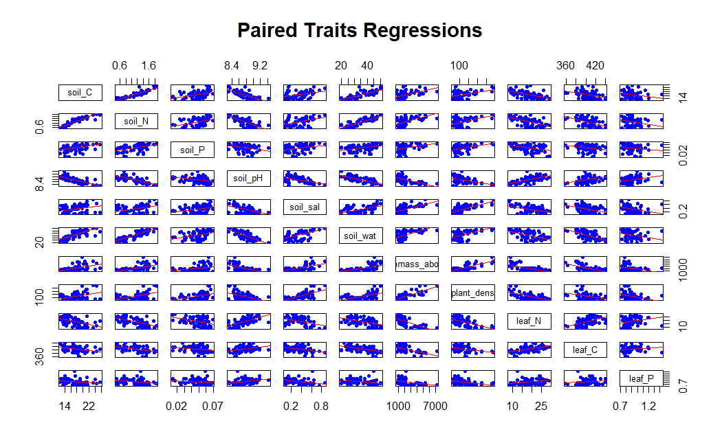
Soil C highly correlated with soil N
Leaf N highly correlated with soil pH

Slide 27
MOST INFLUENTIAL TRAITS OF PC1
Variable | PC1
soil C | -0.3270867
soil N | -0.3547747
soil P | -0.2202713
soil pH | 0.3376054
soil salinity | -0.2806422
soil water | -0.3539508
biomass above ground | -0.3274486
plant density | -0.3154603
leaf N | 0.3142092
leaf C | 0.2491950
leaf P | 0.1817902
↑Leaf N
↑Soil pH
↓Soil N
↓Soil C
↓Plant Biomass
↓Plant Density

Slide 28
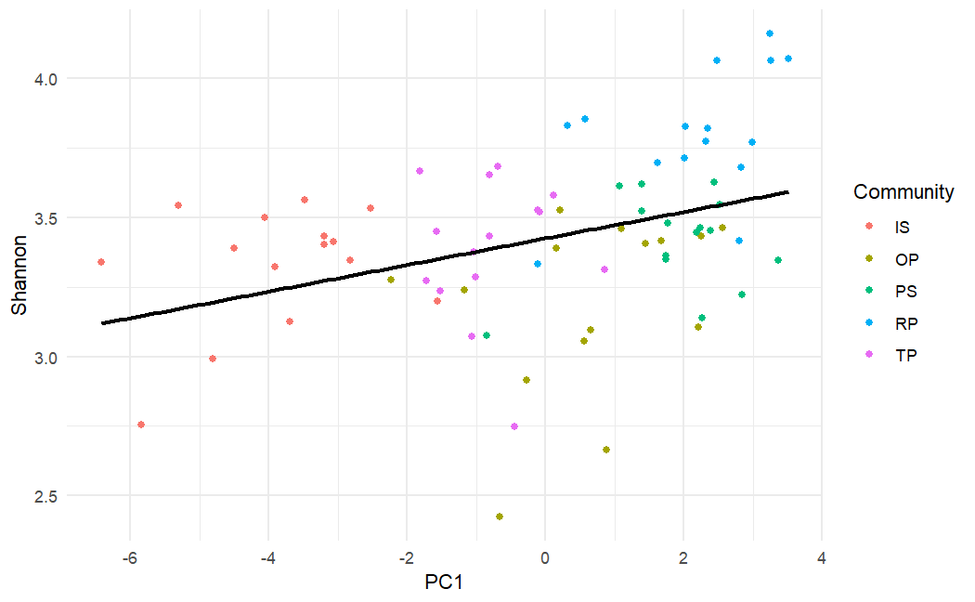
A change is PC1 is associated with a change in all of our traits
Highest at low PC1
Highest at high PC1
↑ soil N + C
↑ plant biomass
↑ plant density
↑ leaf N
↑ Soil pH

Slide 29
REVIEW OF KEY RESULTS
The restored phragmites community had the highest Shannon diversity
There is a significant positive relationship between PC1 and Shannon diversity
Higher PC1 values are associated with increased leaf N and soil pH, and lower soil N, plant biomass and plant density
Differences in community is responsible for 4.1% of the variance in Shannon diversity

Slide 30
H2: Soil and Plant traits represented by principal component axes differ in how they predict arthropod diversity across different communities.
H1: Soil and plant traits represented by principal component axes (PC1 and PC2) are strong predictors of arthropod diversity across all communities.
Finding: PC1 explained 55.64% and PC2 explained 10.5% of the variation in Shannon diversity scores
Finding: Differences in community were responsible for 4.1% of variation in Shannon diversity.

Slide 31
DID WE ANSWER OUR QUESTIONS?
OUR MAIN QUESTIONS:
Q: Do different saltmarsh communities differ in their Shannon diversity?
A: YES!
^^why does the original native wetland have the lowest diversity??
Notes:
include data sources used, statistical tests and why used,

Slide 32
Q: Across all plant communities, which soil or plant trait(s) is/are the strongest predictor of Shannon diversity?
Our Findings:
Findings from Jiang et al. :
↑Leaf N
↑Soil pH
↓Soil N
↓Soil C
↓Plant Biomass
↓Plant Density
Leaf N
Plant Biomass
Plant Density
Soil Salinity
**note -no direction!

Slide 33
DID WE ANSWER OUR QUESTIONS?
Q: Does/do the predictor trait(s) differ based on different community types?
A: NO!
A: ONLY DIFFERENCE WAS BASELINE SHANNON DIVERSITY!
Notes:
include data sources used, statistical tests and why used,

Slide 34

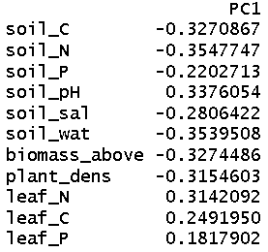
MAIN LIMITATION
PCA are hard to interpret!
What does “PC1” really mean, biologically?
Cannot extract “the best predictor” easily!
Many traits with similar magnitudes!

Slide 35
THANK YOU
QUESTIONS?

